Slide 1

Week 5: Expansions & self-repair sequences
Ryan Ka Yau Lai
University of California, Santa Barbara

Slide 2
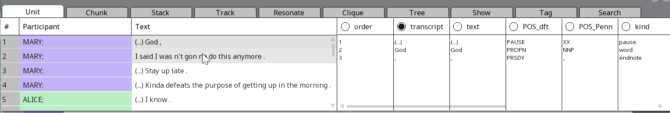
While we’re waiting …
Open SBC007/SBC002 on Rezonator
Preferably a previously saved version
Open the audio file
Change active display to the transcript field
Note today’s codeword and question on the board
Shameless plug: You can still enroll in LING 194 Visualising language in conversational interactions, which I teach in summer!
Possibility of getting a scholarship

Slide 3
In this section, we will …
Identify
Identify the three components of a repair sequence
Distinguish
Distinguish self- and other- initiation and repair
Name
Name the different locations where self-repair can appear within a larger sequence
Recognise
Recognise repair in Rezonator
Name
Name the three expansion types

Slide 4

Question of the day
Identify and categorise one instance of repair in SBC007 or SBC002, telling me what the trouble source, initiation, and repair are.
[Please send me a screenshot if possible]

Slide 5

Any questions on questions?

Slide 6
Quick tips on Show 2
Cut to the chase – don’t waste words on unnecessary background / mention things just because I did in section
Intro/conclusion can be brief
Remember the three musketeers – grammar/syntax, intonation/prosody, pragmatics/meaning and try to get evidence from these sources to support all your arguments
Read my Show #1 comments + our email and don’t repeat mistakes
Show TCU stacks for the Q & A, hide everything else
Use the assigned text for your group

Slide 7
Quick warning before we jump to the next topic …
There are a lot of technical concepts and terms
If you can understand and apply those concepts correctly, that’s great!
If you don’t understand them, the more important thing is to understand the examples and how to describe what’s going on using linguistic evidence
Feel free to stop me if I’m going too fast

Slide 8

Expansion sequences

Slide 9
The idea of expansions
Pre-expansion
First pair part
Insert expansion
Post-expansion
Second pair part
Note: expansions can themselves be expanded. This is very common for post-expansions; they can have more post-expansions.

Slide 10
Pre-expansion
Summons
Pre-telling, pre-invitation, etc.
Pre-pre
Insert expansion
Post-first (repair)
Pre-second
Post-expansion
Sequence-closing third
Post-completion musing
Non-minimal post-expansion (repair)

Slide 11
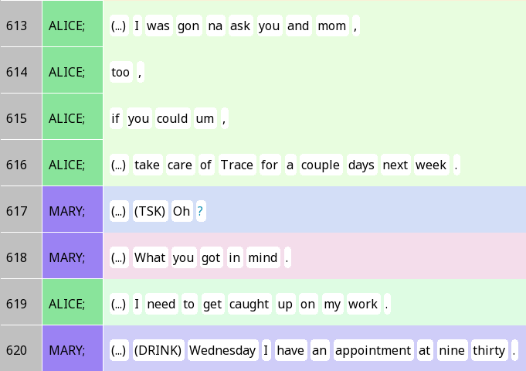

Insert sequences
What is Mary doing in 617-618?

Slide 12
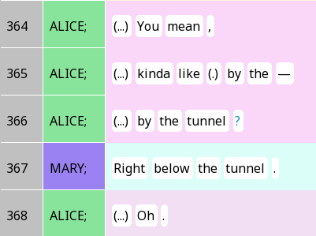
Sequence closing thirds (a.k.a. minimal post expansion)

Slide 13
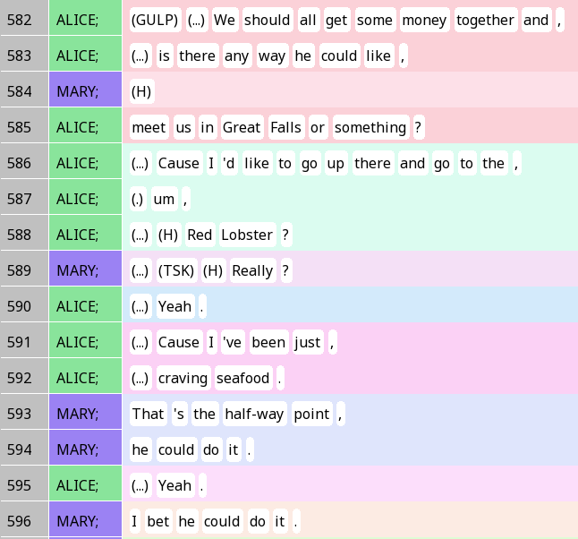

Insert sequence + Non-minimal post-expansions

Slide 14

Repair
When there is a difficulty in speaking or listening, and we want to ‘fix’ it
Does not have to be an ‘error’ + a ‘correction’ (although it often is)
Non-error example: When you couldn’t hear someone say something because you were speaking over them.
(Happens quite a lot in SBC002 …)

Slide 15
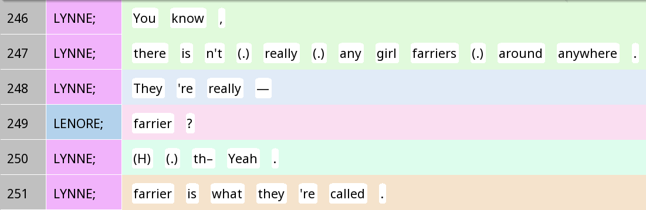
The three components of a repair sequence
Trouble source
Initiation
Completion

Slide 16
The four-way typology
Initiation
 | Self | Other
Self | Self-initiated self-repair ‘fix what you said yourself’ | Other-initiated self repair ‘get someone to fix what they said’
Other | Self-initiated other-repair ‘get someone else to fix what you said’ | Other-initiated other-repair ‘fix what someone else said’
Completion

Slide 17
Where to find self-repair
Self-initiated
Within TCU
Transition space (i.e. after TRP)
Third position
Other-initiated
Post-first insert
Post-expansion
Other

Slide 18
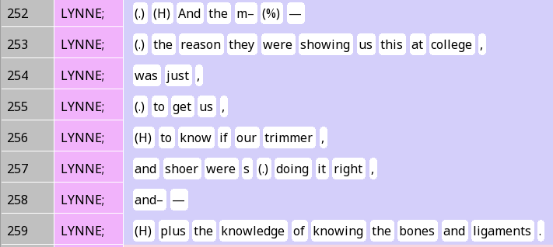
Self-initiated self-repair: Same TCU
Trouble source
Initiation
Completion

Slide 19
Self-initiated self-repair: Same TCU
Trouble source
Initiation
Evidence for repair initiation?
Completion

Slide 20
Common self-initiation types
Cutting off a word (m-) or intonation unit (It is my –)
Filler words (uh, um)
Lengthening a word (the:)
In English, saying ‘thee’ instead of ‘thuh’ for the
Phrases like I mean

Slide 21
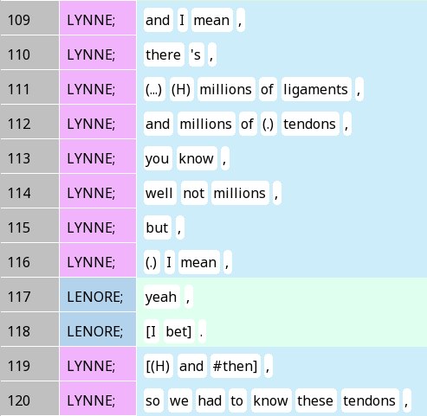
Self-initiated self-repair: Transition space
Trouble source
Evidence for repair initiation?
Initiation
(In) completion

Slide 22
Other-initiated self-repair
Position types
Post-first insert (after FPP)
Non-minimal post-expansion (after SPP)
Pragmatic types
Open request
Restricted request
Restricted offer
Grammmatical types
Open class
Question word
Partial repeat + question word
Partial repeat
Understanding check

Slide 23
Other-initiated self-repair
Position types
Post-first insert (after FPP)
Non-minimal post-expansion (after SPP)
Pragmatic types
Open request
Restricted request
Restricted offer
Grammmatical types
Open class
Question word
Partial repeat + question word
Partial repeat
Understanding check

Slide 24
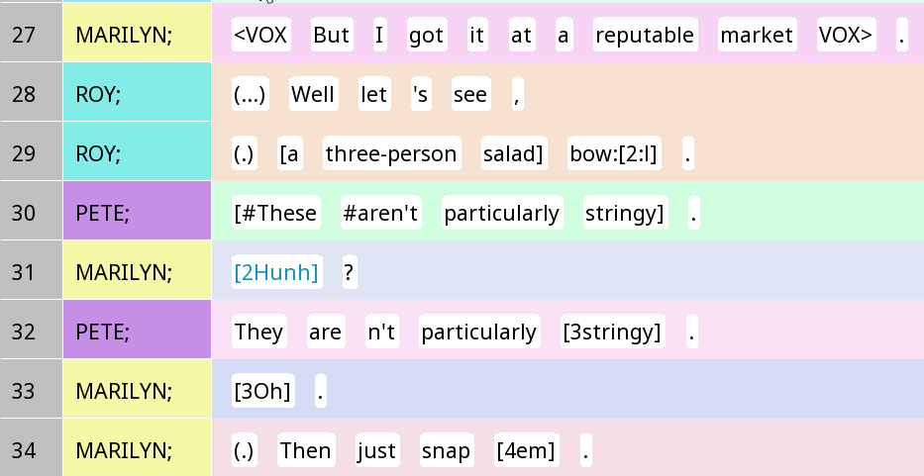
Other-initiated repair: Open request
In the open request type of repair, the trouble source is the entire statement.
Trouble source
Initiation
Completion
Sequence-closing 3rd

Slide 25


Other-initiated repair: Open request
Open class

Slide 26
Other-initiated repair: Common open request expressions
Open class
 | Interjection | Question word | Other
English | Hunh? | What? | Pardon?
Spanish | ¿Eh? | ¿Cómo? | ¿Mande?
Mandarin | 哈？啊？ | 啥？

Slide 27
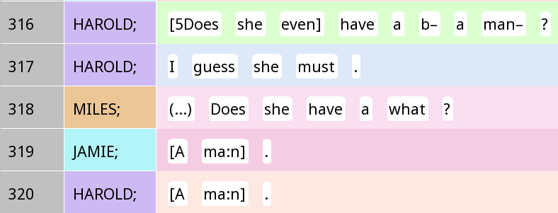
Other-initiated repair: Restricted request
In the restricted request type of repair, the trouble source is a part of the statement.
Trouble source
Partial repeat + question word
Initiation
Completion

Slide 28
Other-initiated repair: Restricted offer
In the restricted request type of repair, the trouble source is only a part of the original statement, and the initiator offers what they think they heard the other person say or meant
Partial repeat
Trouble source
Initiation
Completion

Slide 29
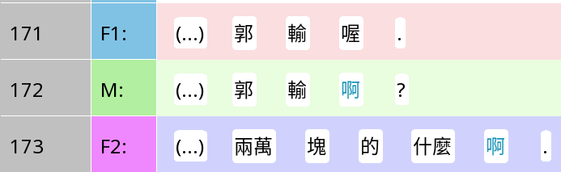
Other-initiated repair in Mandarin: a-suffixed repetition
Trouble source
Question: Is this open request, restricted request or restricted offer?
Kuo lost you know.
Initiation
Kuo lost a?
(No actual completion, but an elaboration to affirm it)
NT$20k or what have you.

Slide 30
Truncated intonation units in Rezonator
Often places where you find repair, especially self-initiated repair
In the Santa Barbara Corpus, use the mdash character: —
(this is not a hyphen! You can’t type it directly!)
You can search for — to find truncated intonation units

Slide 31
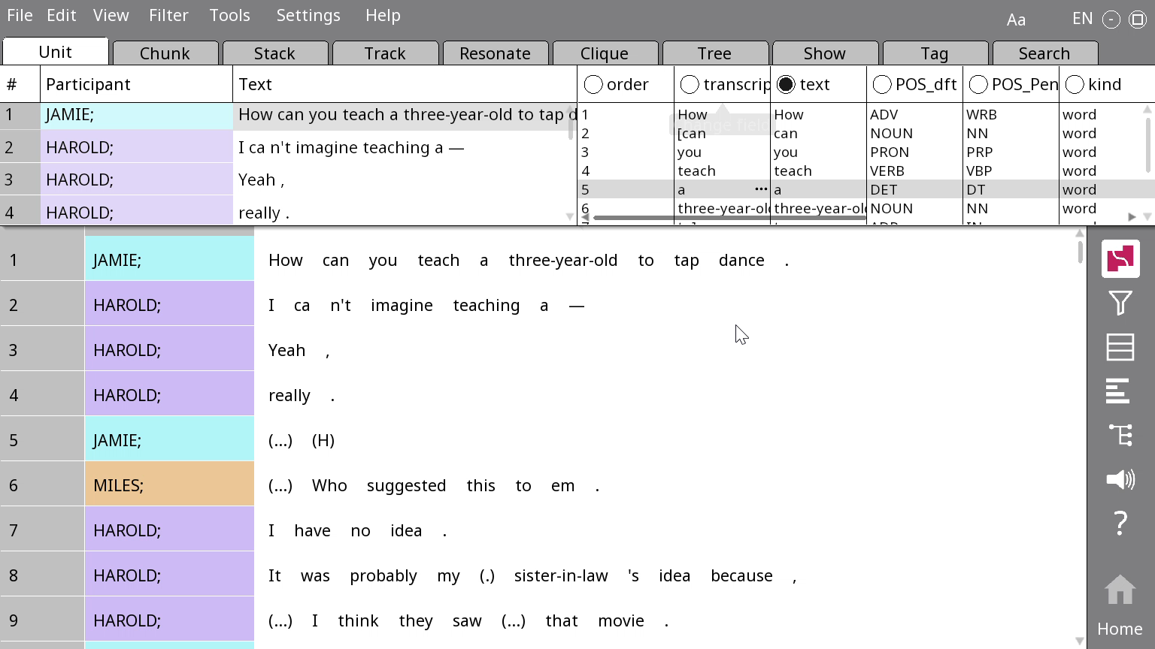

Rezonator search
Use Ctrl+F to bring up the Search screen
Copy-paste — onto the textbox
Click on the magnifying glass icon on the top right
You can now use the Search panel to navigate through examples while seeing context
You can search for other material associated with repair (e.g. hunh for ‘huh’) as well

Slide 32
Your turn!
In groups, at least one person works on SBC007 and one works on SBC002.
Each person should find at least one example of self-repair. If working on SBC002, try to find other-initiated self-repair.
Point out the trouble source, initiation and repair completion. Make sure you have TCU stacks on, especially for other-initiated self-repair.
Present findings within your group.

Slide 33
Appendix slides (if we have time)

Slide 34
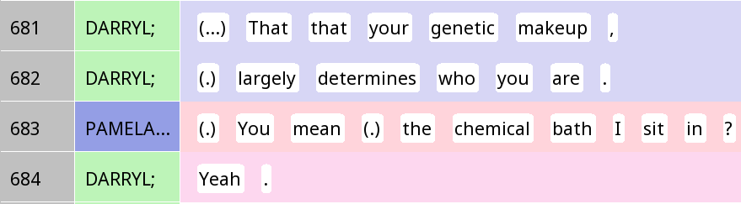
Other-initiated repair: Restricted offer
Understanding check

Slide 35

Q: Did all of your questions appear to be eliciting information from the listener?
[I will not go through this part in detail – please read at home]

Slide 36
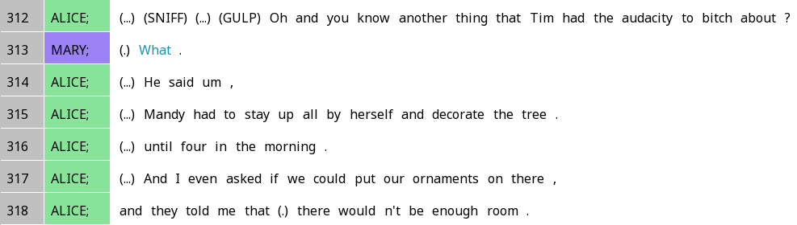
Pre-expansion example: Pre-telling

Slide 37
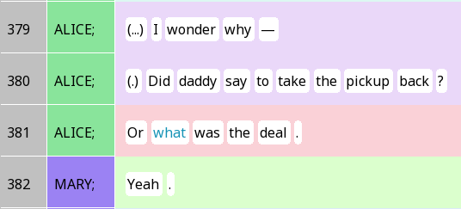
Information-seeking

Slide 38
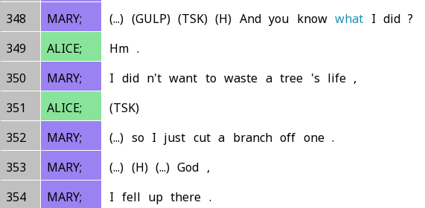
Pre-telling

Slide 39
Request

Slide 40
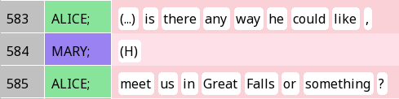
Invitation

